Slide 1
10.1 Overview of Ajax
- History
- Possibility began with the nonstandard iframe
element, which appeared in IE4 and Netscape 4
- An iframe element could be made invisible and
could be used to send asynchronous requests
- Microsoft introduced XmlDocument and XMLHTML
ActiveX objects in IE5 – for asynchronous
requests
- A similar object is now supported by all current
browsers
- Two events ignited widespread interest in Ajax:
1. The appearance of Google Maps and Google
Mail
2. Jesse James Garrett named the new
technology Ajax
- Goal of Ajax is to provide Web-based
applications with responsiveness approaching
that of desk-top applications

Slide 2
10.1 Overview of Ajax (continued)
- Specific kind of Web applications that benefit from
Ajax are those that have frequent interactions
between the client and the server
- Goals are achieved with two different approaches:
1. Client requests are handled asynchronously
2. Only small parts of the current document are
updated
→ SHOW Figure 10.1
- Ajax does not use any new programming
languages or markup languages
- Client side: JavaScript, XML, XHTML, DOM, CSS
- Server side: any (PHP, servlets, ASP.NET, etc.)
- Rather than the original XMLHTML and XmlDocument
objects, now the XMLHttpRequest object is used
- Toolkits are now often used to create Ajax
applications, e.g., Prototype and Dojo
- Also, frameworks, such as ASP.NET,
JavaServer Faces, and Rails

Slide 3
10.2 The Basics of Ajax
- Described through a very simple application
- The application: Helps the user fill a form
- The form gathers client information; asks for the
zip code before the names of the city and state
- As soon as the zip code is entered, the
application sends a request to the server, which
looks up the city and state for the given zip
code and returns them to the form
- Uses JavaScript to put the city and state names
in the form
- Uses PHP on the server to look up the city and
state
- The form
- Must reference the JavaScript code file in its
head
- Must register an event handler on the blur event
of the zip code text box
→ SHOW popcornA.html

Slide 4
10.2 The Basics of Ajax (continued)
- Two functions are required by the application:
1. The blur handler
2. A function to handle the response
-The Request Phase (The blur handler)
- The communication to the server for the
asynchronous request must be made through the
XMLHttpRequest object, so one must be created
var xhr = new XMLHttpRequest();
- When the server receives an asynchronous
request, it sends a sequence of notices, called
callbacks, to the browser (0, …, 4)
- Only the last one is of interest, 4, which
indicates that the response is complete
- The response function is what is called in the
callbacks
- The response function must be registered on the
onreadystatechange property of the XHR object
xhr.onreadystatechange = receivePlace;

Slide 5
10.2 The Basics of Ajax (continued)
- The Request Phase (continued)
- Next, the handler must call the open method of
the XHR object
- Parameters to open:
1. HTTP method, GET or POST, quoted
2. The URL of the response document on the
server
3. A Boolean literal to indicate whether the
request is to be asynchronous (true) or
synchronous (false)
- The parameter (the zip code) must be attached
to the URL (because GET will be used)
xhr.open("GET",
"getCityState.php?zip=" + zip, true);
(getCityState.php is the response document)
- The request is sent with the send method
xhr.send(null);
→ SHOW getPlace.js

Slide 6
10.2 The Basics of Ajax (continued)
- The Response Document
- We’ll use a simple hash of zip codes and names
of cities and states, so this will be very simple
- The response data is produced with a print
statement
→ SHOW getCityState.php
- The Receiver Phase
- A JavaScript function with no parameters
- Fetch the server response (text), split it into its
two parts (city and state), and set the
corresponding text boxes to those values
- The receiver function must be able to access the
XHR
- If it is global, it would be accessible, but it could
be corrupted by simultaneous requests and
responses
- The alternative is to register the actual code of
the receiver, rather than its name

Slide 7
10.2 The Basics of Ajax (continued)
- The Receiver Phase (continued)
- Actions of the receiver function:
1. Put all actions in the then clause of a selector
that checks to see if readyState is 4
2. Get the response value from the responseText
property of the XHR object
3. Split it into its two parts
4. Set the values of the city and state text boxes
→ SHOW popcornA.js
- Cross-Browser Support
- What we have works with FX3+ and IE7+, but not
IE browsers before IE7
- IE5 and IE6 support an ActiveXObject named
Microsoft.XMLHTTP
xhr = new ActiveXObject("Microsoft.XMLHTTP");
→ SHOW getPlace2.js

Slide 8
10.3 Return Document Forms
1. HTML
- Most common approach is to place an empty div
element in the original document
- The innerHTML property of the div element is
assigned the new content
<div id = "replaceable_list">
<h2> 2012 US Champion/Runnerup – baseball </h2>
<ul>
<li> San Francisco Giants </li>
<li> Detroit Tigers </li>
</ul>
</div>
Now, if the user selects a different sport, say
football, the HTML response fragment could have
the following:
<h2> 2012 US Champion/Runnerup – football </h2>
<ul>
<li> Baltimore Ravens </li>
<li> San Francisco 49ers </li>
</ul>

Slide 9
10.3 Return Document Forms (continued)
1. HTML (continued)
Now, the returned fragment can be inserted in the
div element with
var divDom = document.getElementById(
"replaceable_list");
divDom.innerHTML = xhr.responseText;
- The disadvantage of using HTML for the return
document is it works well only if markup is what is
wanted.
- However, oftentimes, it is data that is returned,
in which case it must be parsed out of the
HTML
2. XML
- For the previous example, the following would be
returned:
<header> 2012 US Champion/Runnerup – football
</header>
<list_item> Baltimore Ravens </list_item>
<list_item> San Francisco 49ers </list_item>

Slide 10
10.3 Return Document Forms (continued)
2. XML (continued)
- Problem: the XML returned must also be parsed
- Two approaches:
A. Use the DOM binding parsing methods
- Two disadvantages:
i. Writing the parsing code is tedious
ii. Support for DOM parsing methods is a bit
inconsistent over various browsers
B. Use XSLT style sheets
- For the example, see next page

Slide 11
10.3 Return Document Forms (continued)
2. XML (continued)
<xsl:stylesheet version = "1.0"
xmlns:xsl =
"http://www.w3.org/1999/XSL/Transform"
xmlns = "http://www.w3.org/1999/xhtml" >
<xsl:template match = "/">
<h2> <xsl:value-of select = "header" />
</h2> <br /> <br />
<ul>
<xsl:for-each select = "list_item">
<li> <xsl:value-of select = "list_item"/>
<br />
</li>
</xsl:for-each>
</ul>
</xsl:template>
</xsl:stylesheet>
3. JavaScript Object Notation (JSON)
- Part of the JavaScript standard, 3rd edition
- A method of representing objects as strings, using
two structures
- Easy for people to read and write and easy for
machines to parse and generate
A. Collections of name/value pairs
B. Arrays of values

Slide 12
10.3 Return Document Forms (continued)
3. JavaScript Object Notation (JSON) (continued)
{"employees" :
[
{"name" : "Dew, Dawn", "address" :
"1222 Wet Lane"},
{"name" : "Do, Dick", "address" :
"332 Doer Road"},
{"name" : "Deau, Donna", "address" :
"222 Donne Street"}
]
}
This object consists of one property/value pair,
whose value is an array of three objects, each with
two property/value pairs
Array element access can be used to retrieve the
data elements
var address2 = myObj.employees[1].address;
puts "332 Doer Road" in address2
- JSON objects are returned in responseText
- How does one get the object, myObj?

Slide 13
10.3 Return Document Forms (continued)
3. JavaScript Object Notation (JSON) (continued)
- The object could be obtained by running eval on
the response string
- This is dangerous, because the response
string could have malicious code
- It is safer to get and use a JSON parser
var response = xhr.responseText;
var myObj = JSON.parse(response);
- JSON has at least three advantages over XML
1. JSON representations are smaller
2. parse is much faster than manual parsing or
using XSLT
3. parse is much easier than manual parsing or
using XSLT
- XML is better if the returned data is going to be
integrated with the original document – use XSLT

Slide 14
10.3 Return Document Forms (continued)
3. JavaScript Object Notation (JSON) (continued)
- Example return document:
{"top_two":
[
{"sport": "football", "team":
"Baltimore Ravens"},
{"sport": "football", "team":
"San Francisco 49ers"},
]
}
- The processing to put it in the HTML document:
var myObj = JSON.parse(response);
document.write("<h2> 2010 US Champion/Runnerup"
+ myObj.top_two[0].sport + "</h2>");
document.write("<ul> <li>" +
myObj.top_two[0].team + "</li>");
document.write("<li>" + myObj.top_two[1].team
+ "</li></ul>");

Slide 15
10.4 Ajax Toolkits
- There are many toolkits to help build Ajax
applications, for both server side and client side
- Client-side toolkits:
1. Dojo
- A free JavaScript library of modules, for Ajax
and other parts of Web site software
- Provides commonly needed code and hides the
differences among browsers
- We will use only one function, bind, which
creates an XHR object and builds an Ajax
request
- bind is part of the io module
- To gain access to Dojo module, if dojo.js is in
the dojo subdirectory of where the markup
resides
<script type = "text/javascript"
src = "dojo/dojo.js">
</script>

Slide 16
10.4 Ajax Toolkits (continued)
1. Dojo (continued)
- The bind function takes a single literal object
parameter
- a list of property/value pairs, separated by
commas and delimited by braces
- properties are separated from their values by
colons
- The parameter must include url and load
properties
- The value of the url property is the URL of the
server
- The value of the load property is an
anonymous function that uses the returned
data
- It also should have method, error , and mimetype
properties
The getPlace function, rewritten with Dojo’s bind:
→ SHOW dojo.io.bind

Slide 17
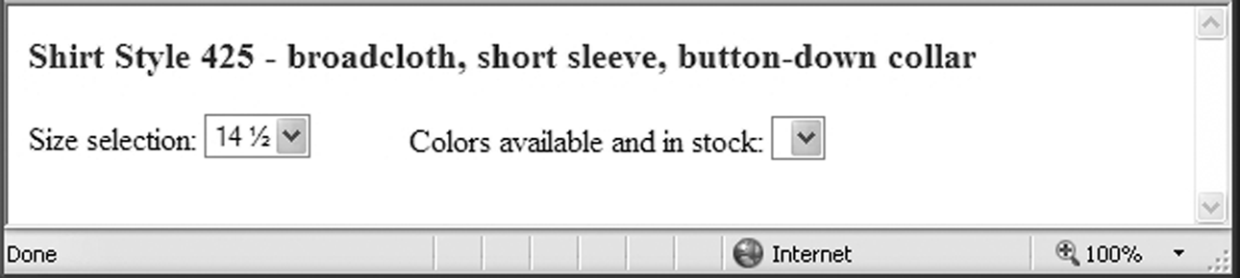
10.4 Ajax Toolkits (continued)
1. Dojo (continued)
- An example – ordering a shirt on-line
- After the user selects a size, present the user
with the colors in that size that are now in stock
- Use Ajax to get the colors for the chosen size
- The original document is for one particular style
of shirt, including a menu for sizes and an empty
menu for colors
→ SHOW shirt.html
→ SHOW shirtstyles.css

Slide 18
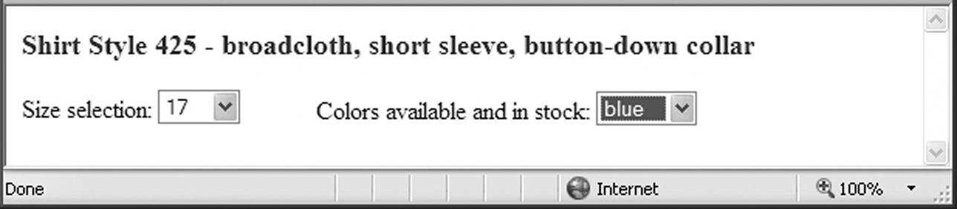
10.4 Ajax Toolkits (continued)
1. Dojo (continued)
- The required JavaScript must define two functions
A. buildMenu – the callback function to build the
menu of colors
- Get the DOM address of the empty select
- If it is not the first request, set options property
to zero
- Split the returned value (a string of colors
separated by commas and spaces)
- Build the Options of the menu and add them to
the menu with add
- The second parameter to add is browser-
dependent; for IE, it is -1; for others, it is null
B. getColors – a wrapper function that calls bind
to create the Ajax request
→ SHOW shirt.js

Slide 19
10.4 Ajax Toolkits (continued)
2. Prototype
- A toolkit that extends JavaScript and provides
tools for Ajax applications
- Includes a large number of functions and
abbreviations of commonly needed JavaScript
code
$("name") is an abbreviation for
document.getElementById("name")
- In Prototype, all of the Ajax functionality is
encapsulated in the Ajax object
- A request is created by creating an object of
Ajax.Request type, sending the parameters to
the constructor
- The first parameter is the URL of the server
- The second parameter is a literal object with
the other required information:
- method – "get" or "post"
- parameters – what to attach to the get
- onSuccess – the anonymous callback
function to handle the return
- onFailure – the anonymous callback
function for failure
→ SHOW the Ajax.request object creation

Slide 20
10.5 Security and Ajax
- Issues:
1. In many cases, Ajax developers put security code
in the client code, but it also must be included
in the server code, because intruders can change
the code on the client
2. Non-Ajax applications often have just one or only
a few server-side sources of responses, but Ajax
applications often have many server-side
programs that produce small amounts of data.
This increases the attack surface of the whole
application.
3. Cross-site scripting – servers providing
JavaScript code as an Ajax response. Such code
could be modified by an intruder before it is run
on the client
- All such code must be scanned before it is
interpreted
- Intruder code could also come to the client
from text boxes used to collect return data
- It could include script tags with malicious
code

